Slide 1

2.0
The Fast, Secure and Professional PHP Framework

Slide 2
Who am I?
Personal
Hafid Mukhlasin
30 years old
Married
Live in Depok
I am moslem and sholat
Activities & Hobbies
Trainer & Developer at a Training Center ( Jakarta )
Freelance Web Developer&Consultant
Sharing knowledges ( blog & group )
Educations
S 1 Teknik Informatika (2008) Universitas Teknologi Yogyakarta
Magister Teknologi Informasi Universitas Indonesia
http://www.hafidmukhlasin.com
https://github.com/hscstudio
hafidmukhlasin@gmail.com
Q

Slide 3

History of PHP
http://php.net/manual/en/history.php.php
Q

Slide 4
History of PHP
PHP 7.0 Performance (2015)
PHP 5.0 OOP, namespace, traits, closures (2004)
PHP 4.0 Zend Engine (2000)
PHP 3.0 Many Features (1998)
PHP 2.0 Support Database (1997)
Init by Rasmus Ledorf (1994/1995)
http://php.net/manual/en/history.php.php

Slide 5
Statistic of PHP Usage
http://w3techs.com/technologies/history_overview/programming_language

Slide 6



Statistic of PHP Usage
http://w3techs.com/technologies/history_overview/programming_language
Q

Slide 7
History of PHP Framework
https://github.com/pmjones/php-history

Slide 8
Map of PHP Framework *)
Prado
2
3
Yii 1
1.1
Yii 2
Symfony
2
Laravel
3
4
Laravel 5
Cake
2
3
<= 2003 Horder, Mojavi
Zend
2
CI
2
3
Kohana
3
2005
2006
2007
2008
2009
2010
2011
2012
2013
2014
2015
2016
2004
*) only fullstack & non c ext

Slide 9
What’s Yii?
http://www.yiiframework.com

Slide 10
What’s Yii
Yii is PHP Framework that developed by Qiang Xue at 2006 and release 2008
Yii comes with rich features: MVC, DAO/ActiveRecord, I18N/L10N, caching, authentication and role-based access control, scaffolding, testing, etc. It can reduce your development time significantly.
Yii support new technology: Composer, almost PSR, PHP7, HHVM
Latest version 2.0.7 (Feb 2016)
Official site : http://www.yiiframework.com

Slide 11
PHP Standard Recommendation
http://www.php-fig.org (PHP Framework Interop Group)
Yii is part of PHP FIG

Slide 12
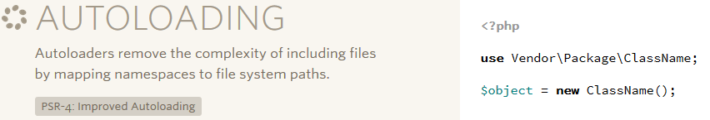
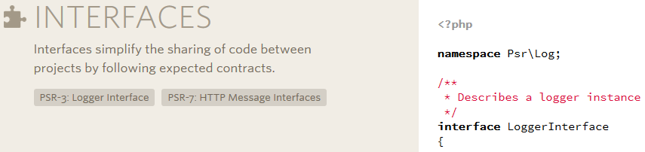
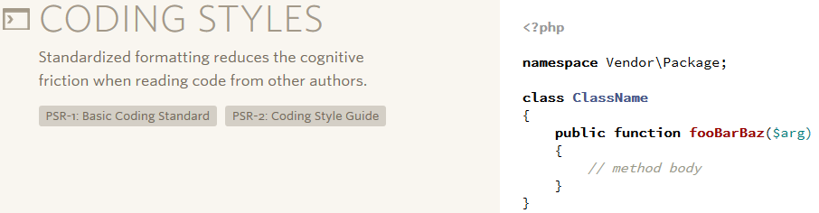
PSR
Ex.
StudlyCaps for class name
camelCase for method name

Slide 13
Installation
http://www.yiiframework.com/download
prefered way using composer https://getcomposer.org

Slide 14
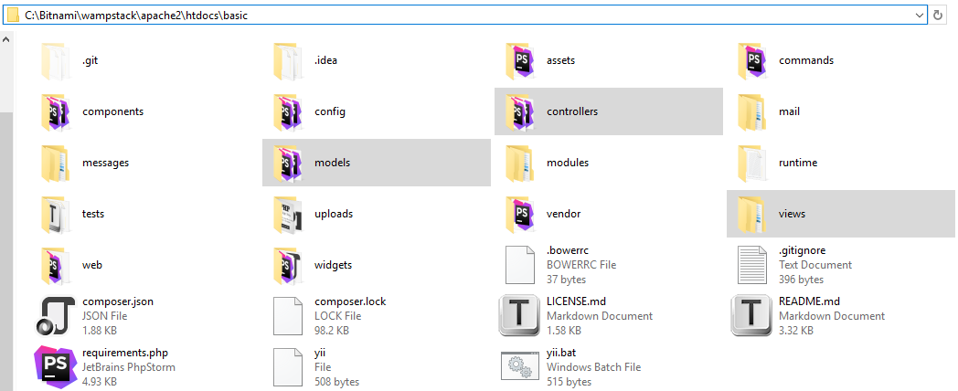
What’s installed?

Slide 15

Online Installation via Composer
composer global require "fxp/composer-asset-plugin:~1.1.1"
composer create-project --prefer-dist yiisoft/yii2-app-basic basic

Slide 16
Running Yii with Built-in PHP Web Server
cd web
php yii serve --port=8080

Slide 17





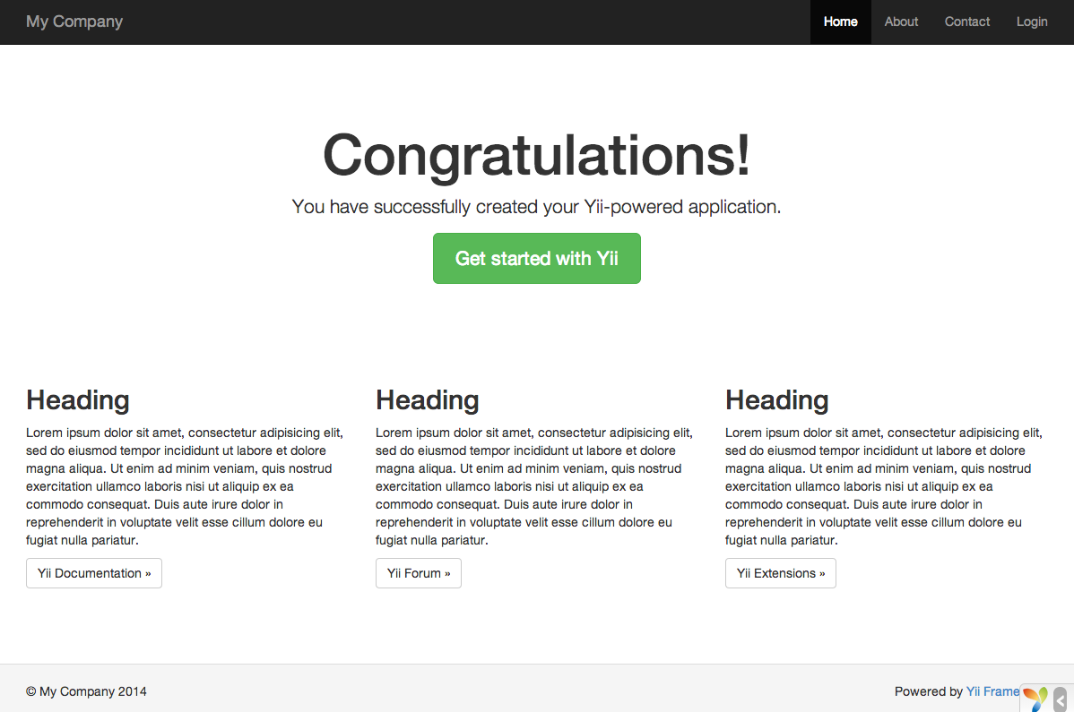
Web page title
http://localhost:8080

Slide 18
Architecture of Yii

Slide 19
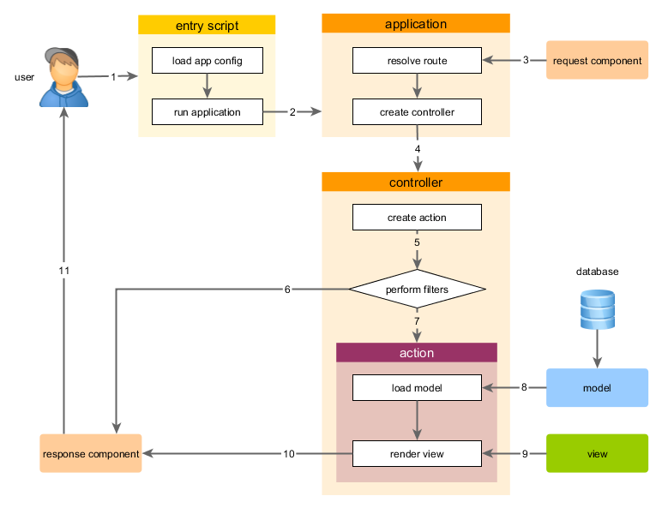
Application Life Cycle

Slide 20
Entryscript: app/web/index.php
<?php // comment out the following two lines when deployed to production defined('YII_DEBUG') or define('YII_DEBUG', true); defined('YII_ENV') or define('YII_ENV', 'dev'); require(__DIR__ . '/../vendor/autoload.php'); require(__DIR__ . '/../vendor/yiisoft/yii2/Yii.php'); $config = require(__DIR__ . '/../config/web.php'); (new yii\web\Application($config))->run();

Slide 21
Why You should choose Yii?

Slide 22
Good Performance
Yes, it’s not best, but good ☺

Slide 23
Yii on PHP 5 vs PHP 7
Spesification
Core 1
Memory 512 MB
20 GB SSD
Ubuntu
Apache
PHP 5/7
PHP opCache enabled
https://github.com/kenjis/php-framework-benchmark

Slide 24
Why PHP 7 faster than 5
http://www.slideshare.net/petrabarus/whats-new-in-php7

Slide 25
Good Security

Slide 26
Built-in Security Feature
Authentication & Authorization
Tools to deal with SQL injections, XSS attacks, CSRF attacks
Standard input validation & output filtering
Easy to use other security feature: hash password, encrypt & decrypt
Reviewed by web security expert (Tom Worster and Anthony)

Slide 27
Reduce Our Development Time

Slide 28
Many features to reduce our development time
Support PHP Dependency Manager - Composer
Integrate with User Interface Framework – Twitter Boostrap, and You can use the other
Application Template
Built-in Scafolding Generator – Gii
Centralize Validation in models, (client & server validation)
Many built-in useful Widgets
Automatic routing (by default)
Simplify to create API Restful Web Service
Integrate with Testing Tools - Codeceptions
etc

Slide 29
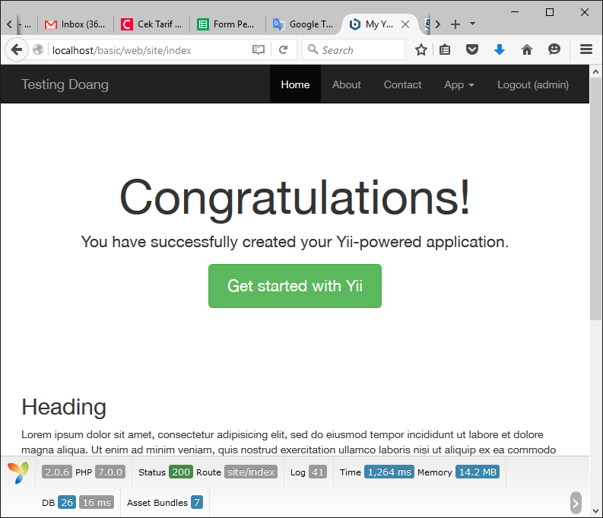
Twitter Bootstrap Ready

Slide 30
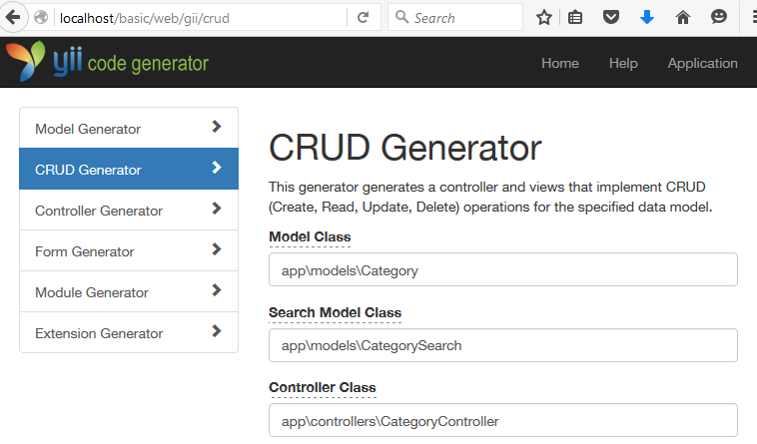
Gii : a magical tool that can write code for you

Slide 31
Centralize Validation in models
<?php namespace app\models; use Yii; ... class Category extends \yii\db\ActiveRecord { public static function tableName() { return 'category'; } public function rules() { return [ [['title'], 'required'], [['title', 'description'], 'string', 'max' => 255] ]; }

Slide 32
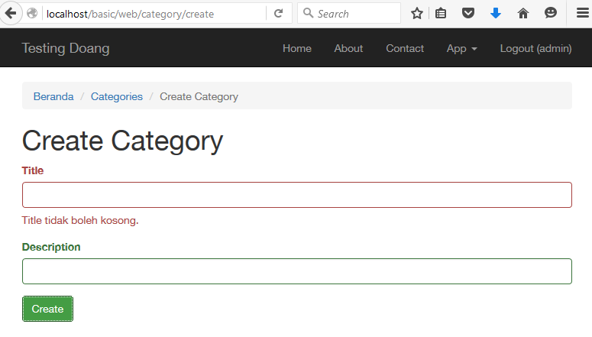
It will trigger client and server validation

Slide 33
Good Versioning & Support
Professional & Reliable PHP Framework

Slide 34
Versioning & Support of Yii
Almost base on semantic versioning
http://semver.org
X.Y.Z
MAJOR
MINOR
PATCH
v1.1.0
v1.1.17
Yii 1
Yii 2 Public Preview
v2.0.7
Yii 2
2008
2009
2010
2011
2012
2013
2014
2015
2016
http://www.yiiframework.com/news/90/update-on-yii-1-1-support-and-end-of-life/

Slide 35
Why is Yii not quick to adopt new technology?
Alexander Makarov (core Yii dev) say
“if we'll adopt new tech too fast w/o supporting what we've built there will be no means using Yii as a framework at all.
It will be thing for cool kids to play. Not to build real projects that are here to stay for decades”

Slide 36
Not One Man Show

Slide 37
Current Core Team of Yii
Qiang Xue
Project Lead
USA
Alexander Makarov
Core Framework Developer
Russia
Maurizio Domba C
Community Management
Croatia
Carsten Brandt
Core Framework Developer
Germany
Dmitry Naumenko
Core Framework Developer
Ukraine
Klimov Paul
Core Framework Developer
Ukraine

Slide 38
Good Community Support

Slide 39
Statistic of Community Support
https://web.facebook.com/groups/yiitalk 28.052
https://web.facebook.com/groups/yii.indonesia 23.140
http://www.yiiframework.com/forum 179.865
http://stackoverflow.com/search?q=yii 41.124
https://github.com/yiisoft/yii2 fork: 4453, star 7591
update: 22 Feb 2016

Slide 40
Who is using Yii?

Slide 41
Website is using Yii 2?
http://www.humhub.org (cms social media)
http://www.ftzmall.com (onlineshop)
http://www.tvmaze.com (TV online)
http://logistics.qwintry.com (logistics)
http://almundo.com.ar (ticketing)
http://m.urbanindo.com (jual beli properti)
http://www.rajamobil.com (jual beli mobil)
http://www.chasebrandbali.com (jual beli pakaian)
http://smartgorontalo.net (smart city gorontalo)
https://pictalogi.com (digital publishing)

Slide 42
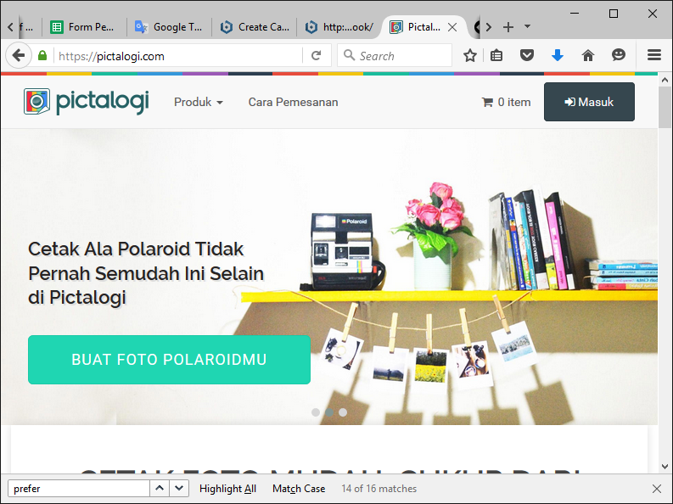
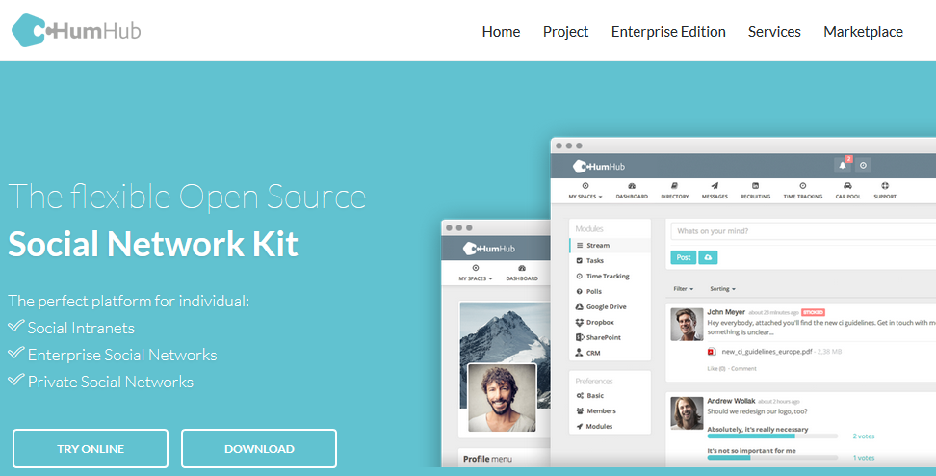
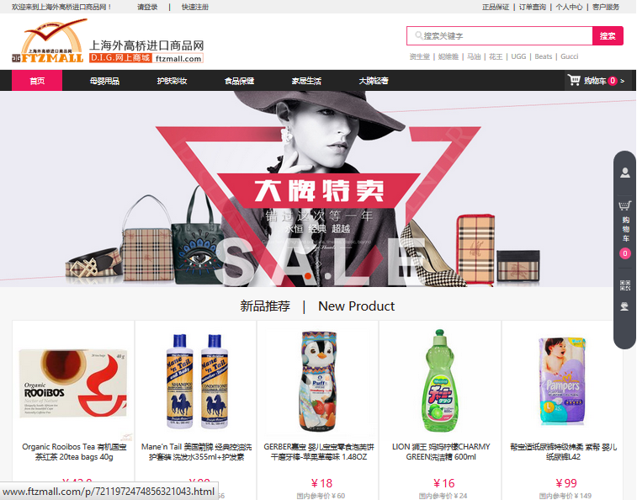
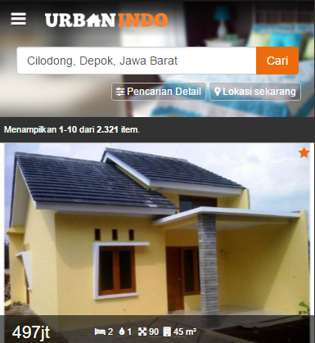
Yii 2

Slide 43
Where should we begin learn?
http://www.yiiframework.com/doc-2.0/guide-index.html
requirement: knowledge about PHP & MySQL

Slide 44

My Book for Yii
Membangun Aplikasi Profesional Berbasis Web Menggunakan Yii Framework
Author : Hafid Mukhlasin
Publishing : Self
Pages : x + 497 Halaman (A5)
Edition : ke-1, Februari 2016
Language : Bahasa Indonesia
Format: Hard copy only (cetak)
http://hscstudio.github.io/yii2-book-id

Slide 45
Any Question?

Slide 46
Thank You
hafidmukhlasin@gmail.com

